Slide 1
Generative and Discriminative Voxel Modeling
Andrew Brock

Slide 2
Introduction
Choice of representation is key!

Slide 3
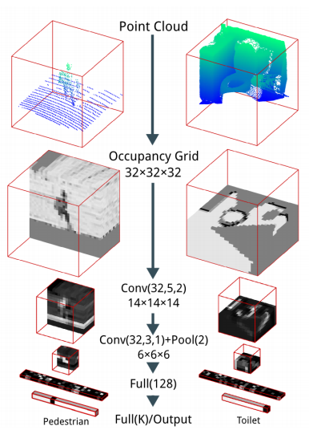
Background: VoxNet
Maturana et al. 2015

Slide 4
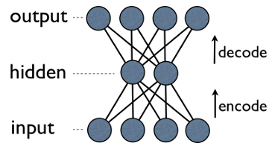
Background: VAEs

Slide 5
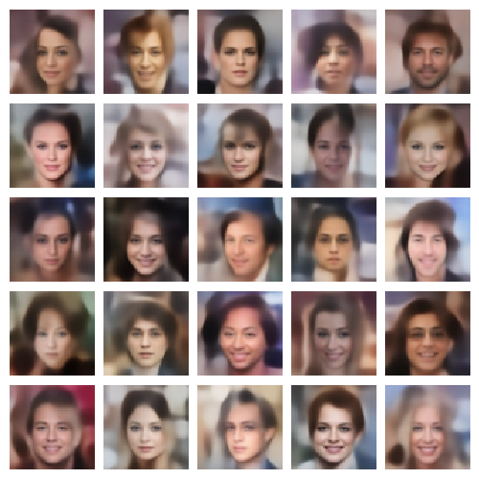
Background: VAEs

Slide 6
VAE Architecture

Slide 7
Reconstruction Objective
Standard Binary Cross-Entropy
Modified Binary Cross-Entropy

Slide 8
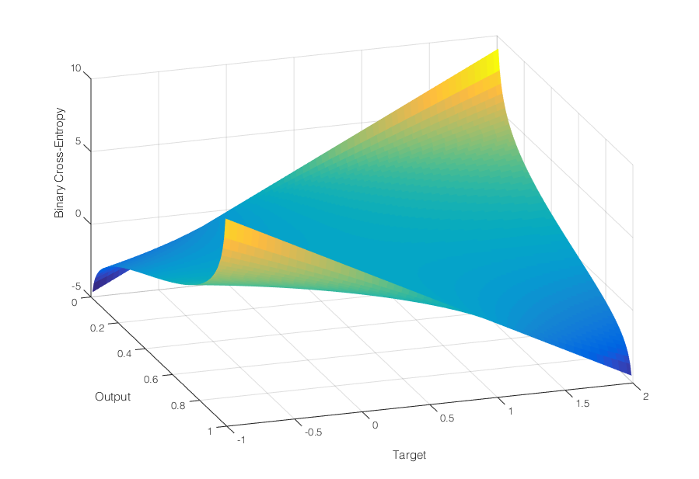
Error Surface

Slide 9
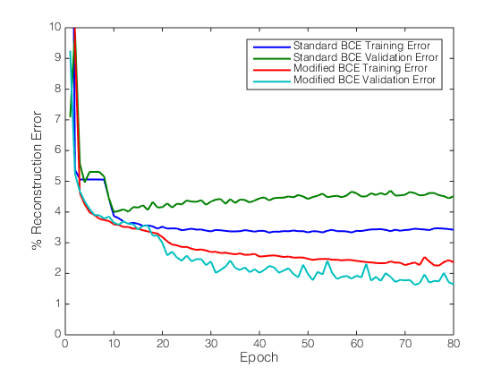
Reconstruction Objective

Slide 10
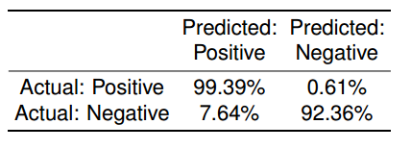
Reconstruction Results

Slide 11
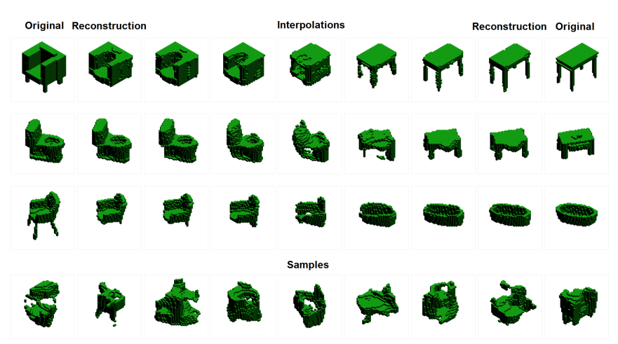
Samples and Interpolations

Slide 12
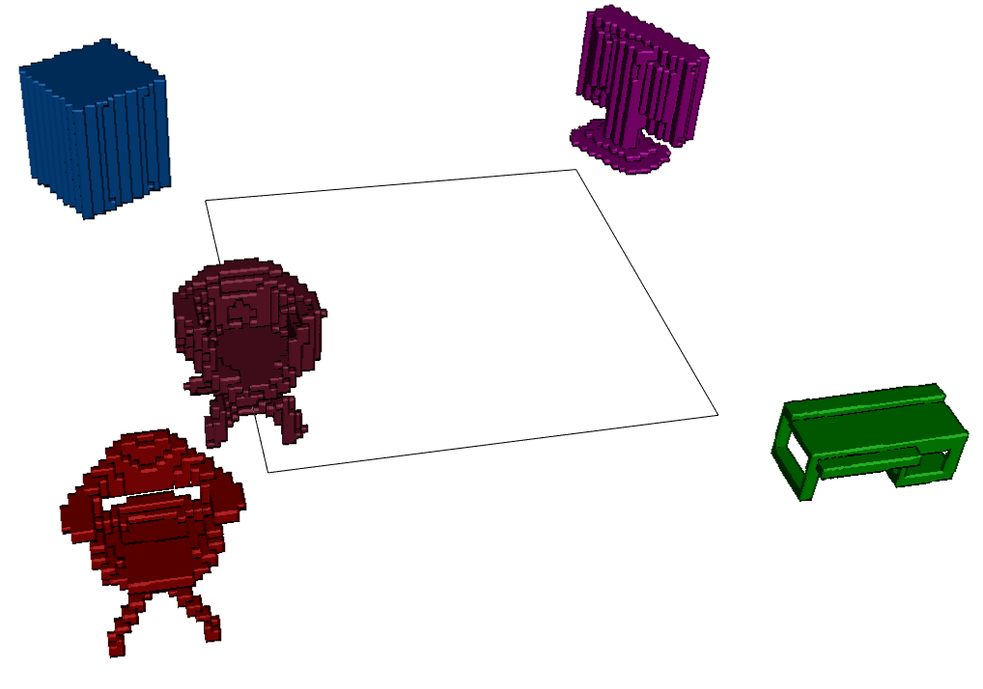
Interface

Slide 13
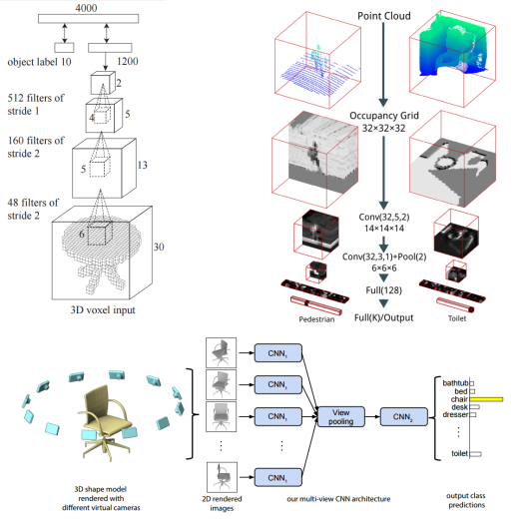
Classification: Prior Art

Slide 14
Classification: Low-Hanging Fruit
All previous works only considered relatively shallow volumetric ConvNets (or non-volumetric ConvNets).

Slide 15
Classification: Low-Hanging Fruit
All previous works only considered relatively shallow volumetric ConvNets (or non-volumetric ConvNets).
Utterly unsurprisingly, deeper nets perform much better.

Slide 16
Classification: Low-Hanging Fruit
All previous works only considered relatively shallow volumetric ConvNets (or non-volumetric ConvNets).
Utterly unsurprisingly, deeper nets perform much better.
But, that doesn’t mean we have to be naïve!

Slide 17
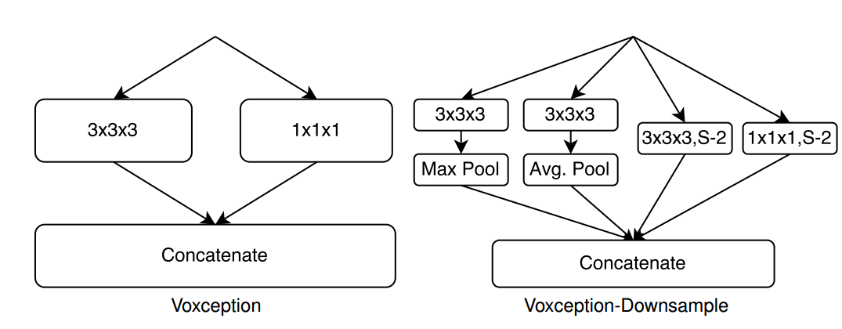
Voxception

Slide 18
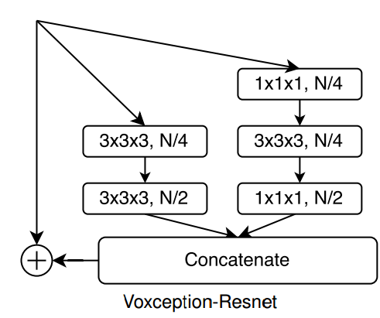
Voxception-ResNet

Slide 19
Voxception-ResNet

Slide 20
Data and Training
-Use ELUs, Batch-Norm, and pre-activation
-Change the binary voxel range to {-1,5} to encourage the network to pay more attention to positive entries (and to improve its ability to learn about negative entries)
-Warm up on 12 rotated-instance set (12 epochs) then anneal fine-tune on 24 rotated-instances.

Slide 21
Orthogonal Regularization
Initializing weights with orthogonal matrices works well…so why not keep them orthogonal?

Slide 22
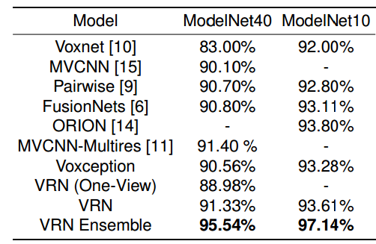
Results

Slide 23
Results
…but don’t pay too much attention to the numbers

Slide 24
Thanks!

